Slide 1
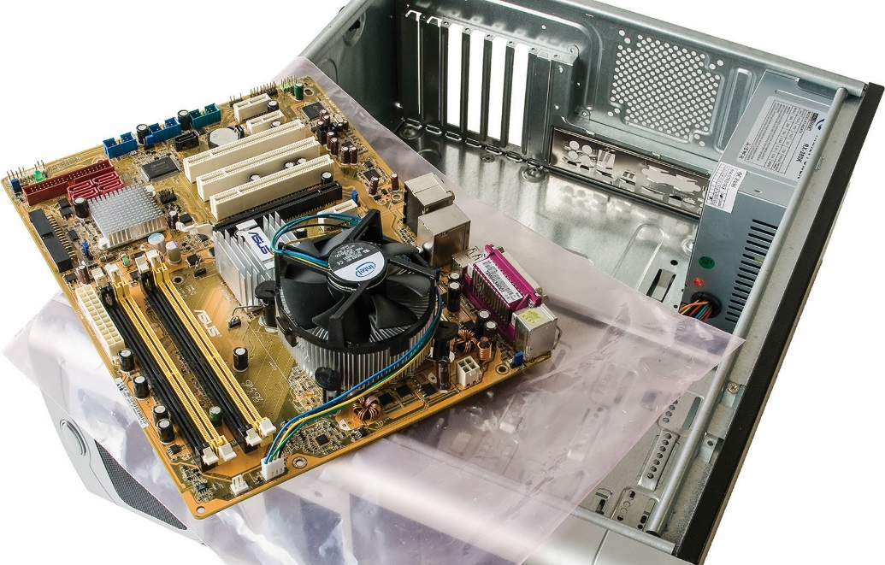
IT Essentials (CompTIA A+) Ch. 12
Building a PC
Chapter 12

Slide 2
Overview
In this chapter, you will learn how to:
Research and spec out specialized PCs
Install and upgrade Windows
Describe Windows post-installation best practices
Notes:
2

Slide 3
Specialized Custom PCs
Evaluating parts
Read the reviews.
Search for part reviews by name and model number.
Types of reviews include: industry reviews written by professionals and personal reviews written by people who purchased and use the part.
Read the fine print.
Learn everything you can about the part.
Read the technical specifications.
Check the return and warranty policy of the manufacturer and the retailer.
Notes:
Building your first PC is both fun and scary. This is the first time you bring together everything you know about hardware. You’ll make mistakes, and some brand-new piece of equipment you buy won’t work the first time. You’ll mount the CPU wrong and the system won’t boot. That huge tower case with 23 fans will make too much noise and you’ll hate it. But for all these mistakes, don’t lose track of the fact that you’re building your own PC.

Slide 4
Specialized Custom PCs
Compare and contrast.
Before you buy a part, see what folks are saying about the competitors’ parts.
Compare cost, performance, power usage, specs, etc.
Put it in your hand.
If there is an opportunity, handle the part.
Open the box, read the instructions, and see what parts come with it.
Talk to sales people about alternatives for that part, returns, etc.

Slide 5
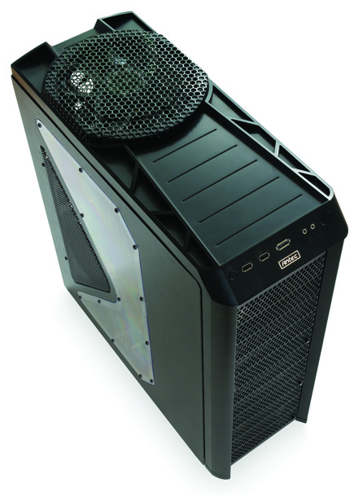
Standard Workstation Types
Thick client
Thin client
Virtualization workstations
Media workstations
Figure 12.1 A typical thick client

Slide 6
Thick Client
A thick client runs a modern operating system and general productivity applications.
Sufficient core hardware to support requirements of typical office and home users
Thick client name does not necessarily describe the physical size of the case or unit.
Most contemporary components are powerful enough to build a useful thick client.

Slide 7
Thick Client
Minimum hardware requirements for modern Windows (up to Windows 10)
Table 12.1 | Hardware Requirements for Windows
Component |  | Hardware Requirements
CPU¹ |  | 1 gigahertz (GHz) or faster 32-bit (x86) or 64-bit (x64)
Memory² |  | 1 gigabyte (GB) RAM (32-bit) or 2 GB RAM (64-bit)
Hard drive³ |  | 16 GB available hard drive space (32-bit) or 20 GB (64-bit)
Graphics |  | DirectX 9 graphics device with WDDM driver
Network |  | Internet access
Notes:
Windows Vista can get by with an 800-MHz processor.
Windows Vista requires a minimum 512 MB of RAM for Vista Home Basic.
Windows Vista requires 15 GB of available hard drive space for all editions.
Exam Tip: A standard thick client should meet or exceed the recommended hardware specifications for Windows and offer typical desktop applications, such as office productivity and network applications (like a Web browser and an e-mail client).

Slide 8
Thin Client
A thin client system handles only basic tasks with minimal hardware.
Thin clients usually rely on resources from powerful servers, so they may not have hard drives.
A thin client is cheaper and easier to deploy than a thick client.
Examples of thin clients:
Point-of-sale machines (cash registers)
Office workstations

Slide 9
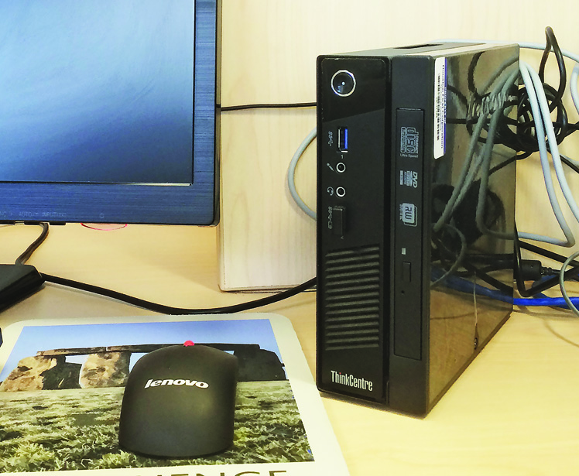
Thin Client
Figure 12.2 Thin client in an office

Slide 10
Virtualization Workstations
Virtualization is a powerful technology that enables you to run more than one operating system at the same time on a single computer.
Virtualized servers can help consolidate multiple machines into one box, saving floor space, electricity, etc.
With workstations, virtualization is most often used to run a second OS within the OS installed on the computer’s hard drive.

Slide 11
Virtualization Workstations
For good performance on a virtualization workstation, install LOTS of RAM.
RAM is the most important thing in virtualization.
A powerful 64-bit CPU with many cores helps virtual machines run smoothly.

Slide 12
Media Workstations
Graphics workstations
Professional photographers and graphic designers need to have the clearest view possible of their images and image editing software.
The primary requirement for a graphics workstation is a large, high-quality monitor.
Many monitors require calibration to accurately display colors.
The workstation should have a fast, multicore CPU, and maximum RAM.

Slide 13
Audio Editing Workstations
Requirements similar to those for graphics workstation
Fast, multicore CPU, lots of RAM, a large monitor, and a large, fast hard drive
Audio interface
Connects to PC with inputs for professional microphones and instruments
Usually connects to computer via USB or FireWire
With a more expensive interface, includes more inputs and produces higher-quality sound

Slide 14
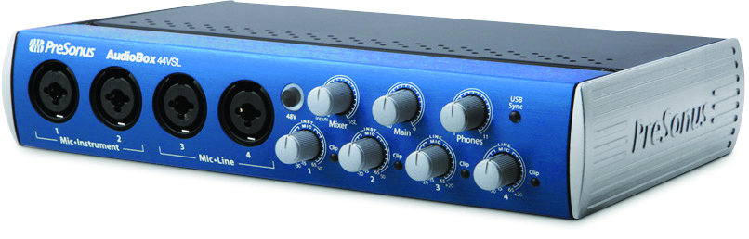
Audio Editing Workstations
Figure 12.3 Audio interface device (photo courtesy of PreSonus)

Slide 15
Audio Editing Workstations
Control surfaces
These specialized input devices mimic the look and feel of older, analog mixing consoles.
Control surfaces feature a large number of programmable inputs.
Controlling the software is much faster and more accurate than with just a mouse and keyboard.
Some also contain an audio interface.

Slide 16
Video Editing Workstations
Combine requirements of a graphics workstation and an audio workstation
Often use two or more color-calibrated monitors
View the video stream on one monitor and the video editor on another monitor.
Require a very powerful CPU paired with as much RAM as possible
Video editing is a far more intensive process than graphics or audio editing.

Slide 17
Video Editing Workstations
Also need high-speed, high-capacity hard drives
Video files can be very large.
Can benefit from a professional-level graphics card
Frequently have the same audio interfaces and control surfaces as an audio workstation
Also may have video interfaces that enable editors to connect to various cameras
Often used with custom keyboards

Slide 18
Specialized Consumer PCs
Building a home server PC
Provides three distinct functions: media streaming, file sharing, and print sharing
Software
Windows allows you to easily share folders, files, and printers.
Open the Devices and Printers applet in the Control Panel, right-click on an installed printer, choose Printer properties, and then check the Share this printer checkbox on the Sharing tab.

Slide 19
Building a Home Server PC
In Windows 7, you can stream media by selecting that option in the Control Panel.
Both Windows Media Player and iTunes have a feature to share media files on a local network.

Slide 20
Building a Home Server PC
Hardware
A wired Gigabit Ethernet NIC for the network
Two hard drives of identical size with as much capacity as you can afford
RAID 1 configuration at a minimum

Slide 21
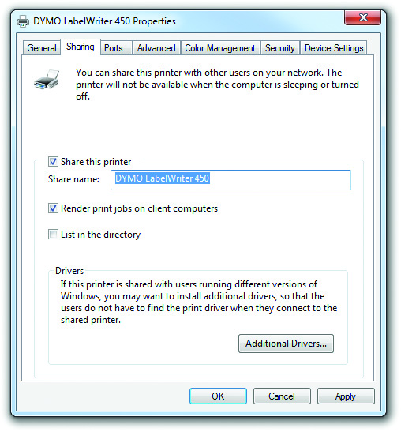
Building a Home Server PC
Figure 12.4 Sharing a printer

Slide 22
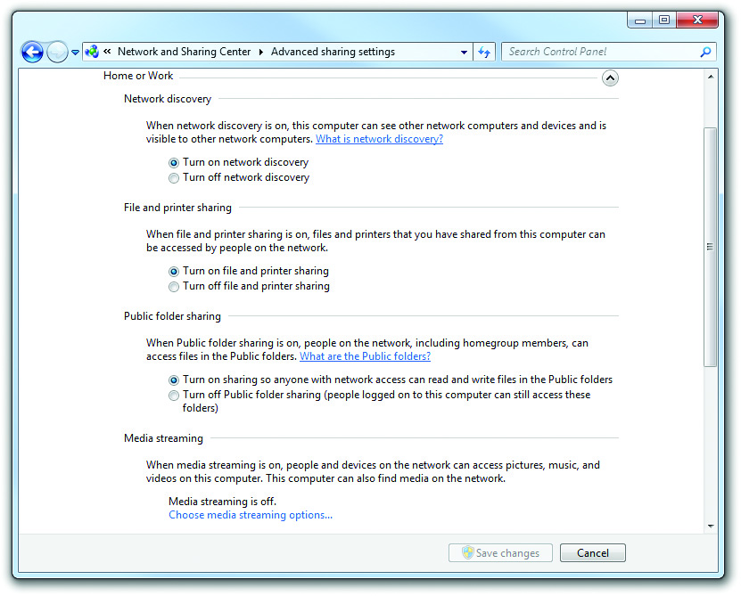
Building a Home Server PC
Figure 12.5 Advanced sharing settings

Slide 23
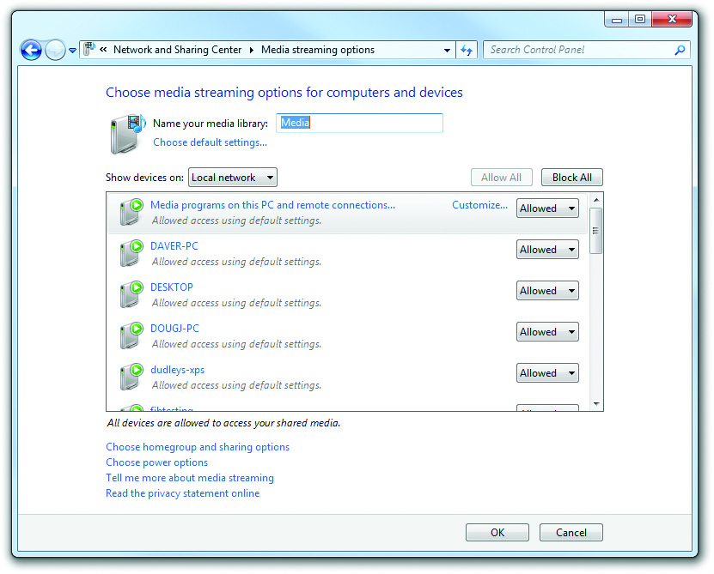
Building a Home Server PC
Figure 12.6 Media streaming options

Slide 24
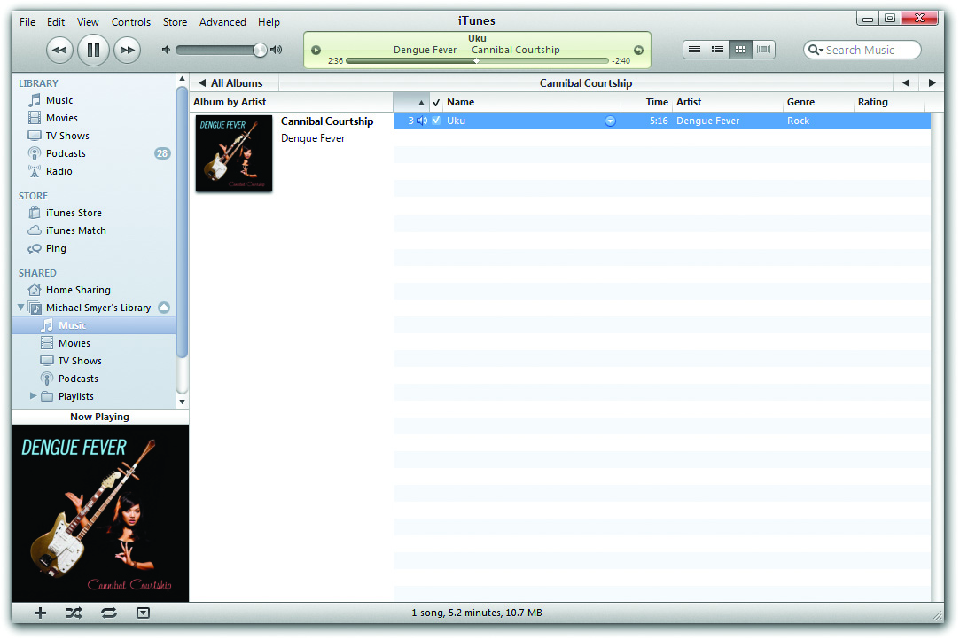
Building a Home Server PC
Figure 12.7 Streaming with iTunes

Slide 25
Home Theater PC
A home theater system enables you to play music and watch movies and television.
Components of an optimal home theater:
A monitor, television, or projector
Surround-sound speakers
A stereo receiver
A home theater PC
Network connectivity (such as a cable box or Ethernet)

Slide 26
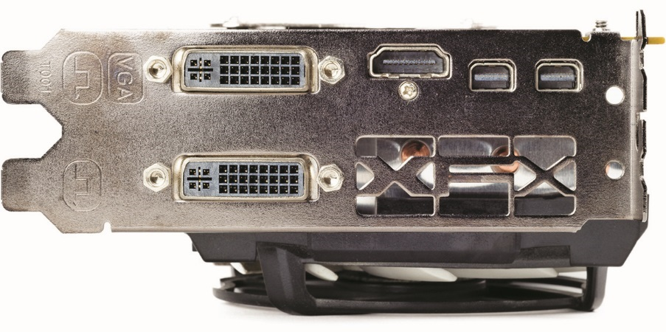
Home Theater PC
Output killer video
A home theater PC must provide support for large monitors at high resolution—usually via an HDMI connector.
Figure 12.8 HDMI output on video card

Slide 27
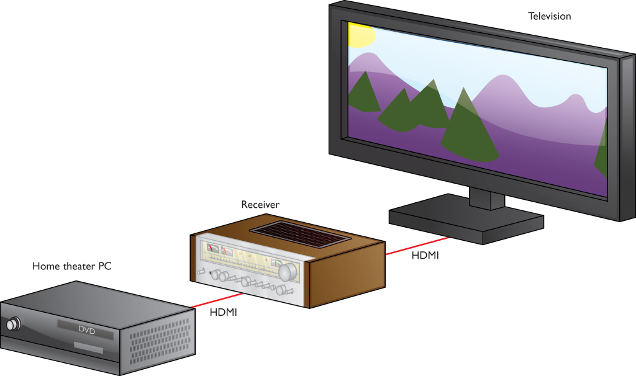
Home Theater PC
Figure 12.9 Television, receiver, home theater PC

Slide 28
Home Theater PC
Play it loudly
The home theater PC needs a sound card or built-in sound processor that supports 5.1 or 7.1 stereo.
For the best output, the sound card connects to the stereo receiver via S/PDIF, through either the optical connector or coaxial connector.
Look cool in the process
A case that stacks nicely with other home theater components is called an HTPC.
Not an industry-standard form factor

Slide 29
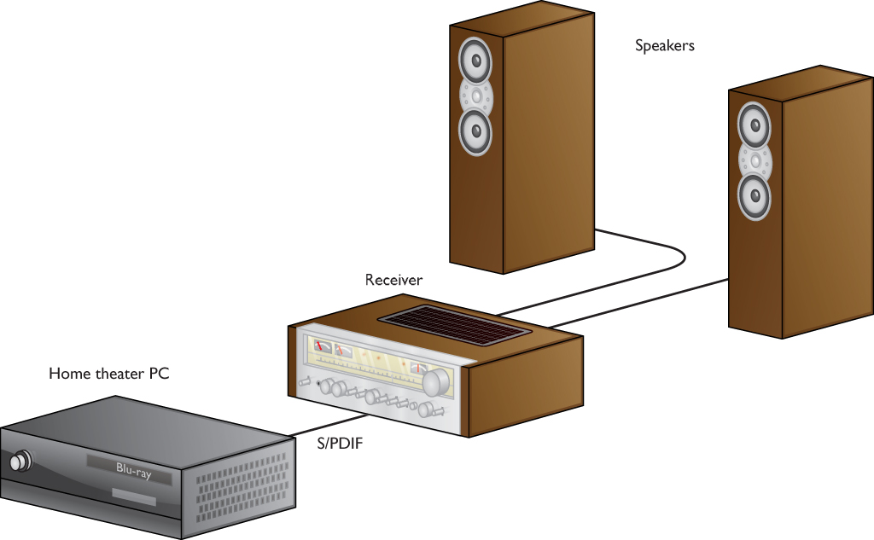
Home Theater PC
Figure 12.10 PC, receiver, speakers

Slide 30
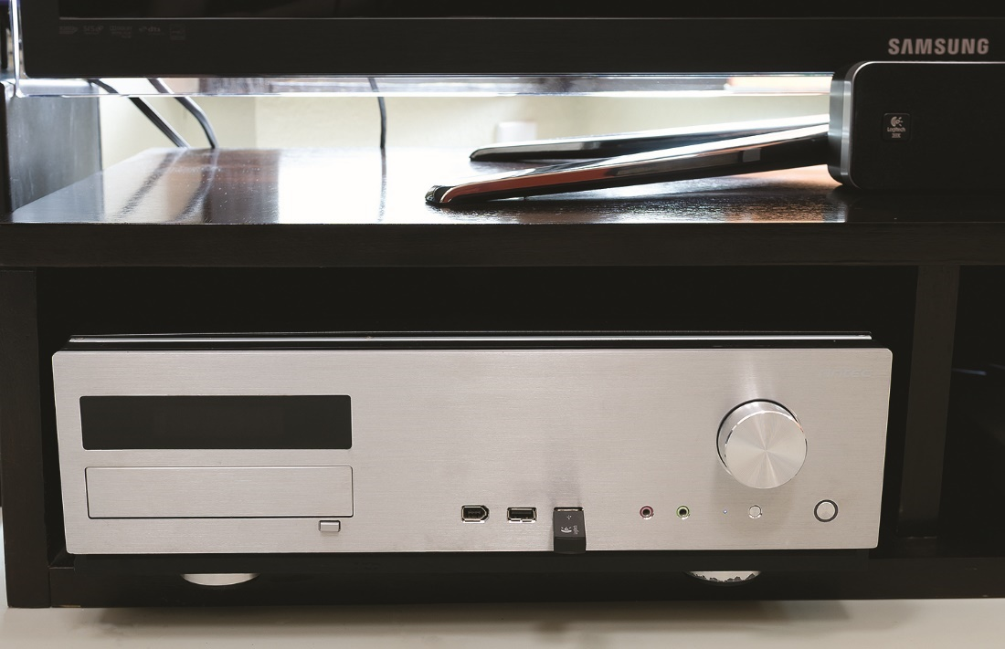
Home Theater PC
Figure 12.13 HTPC case

Slide 31
Home Theater PC
Access the media—streaming and TV
A home theater PC needs access to content, usually through Gigabit Ethernet, to get streaming media.
The home theater could use Wi-Fi (802.11n or 802.11ac), though wired is best, especially for HD content.
PC would not be connected to cable company signal or dedicated optional disk player.
For a television signal through broadcast over the air, the PC needs a television tuner.

Slide 32
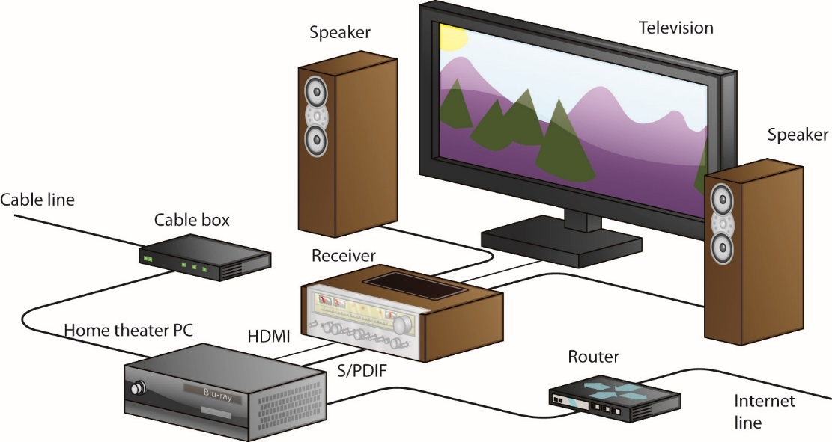
Home Theater PC
Figure 12.14 Final home theater

Slide 33
Home Theater PC
Software tools for playback
After the media center hardware is set up properly, you need software to access streaming media.
Microsoft includes Windows Media Center in some earlier editions of Windows.
If lacking Windows Media Center, you can use a third-party tool, such as Kodi (previously XBMC) or Plex.
Notes:
Microsoft dropped support for both DVD playback and Windows Media Center in Windows 10. If you want to use a Windows 10 machine for a home theater system, you’ll need to use Kodi or Plex.

Slide 34
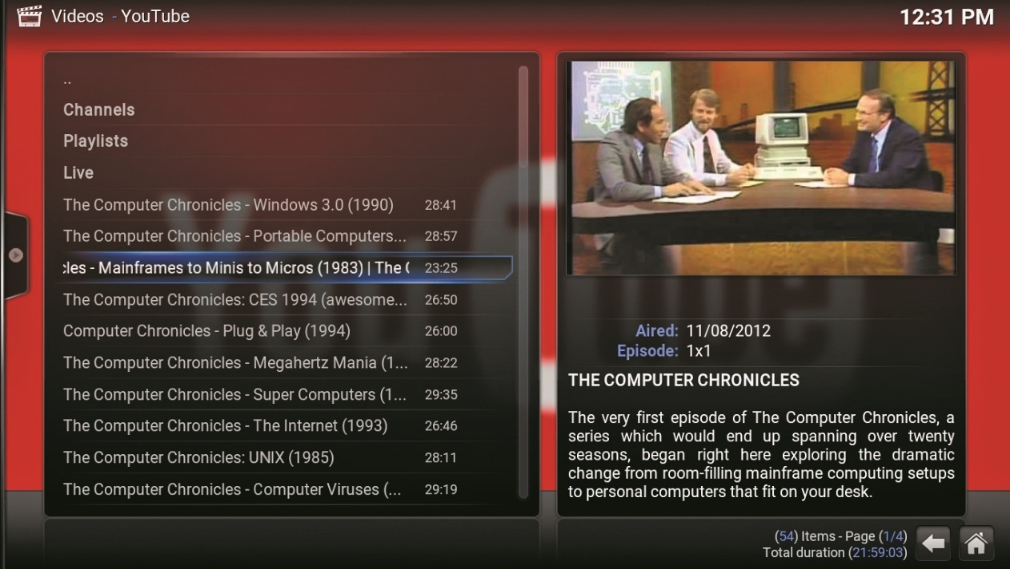
Home Theater PC
Figure 12.15 Default Kodi feeling retro on YouTube

Slide 35
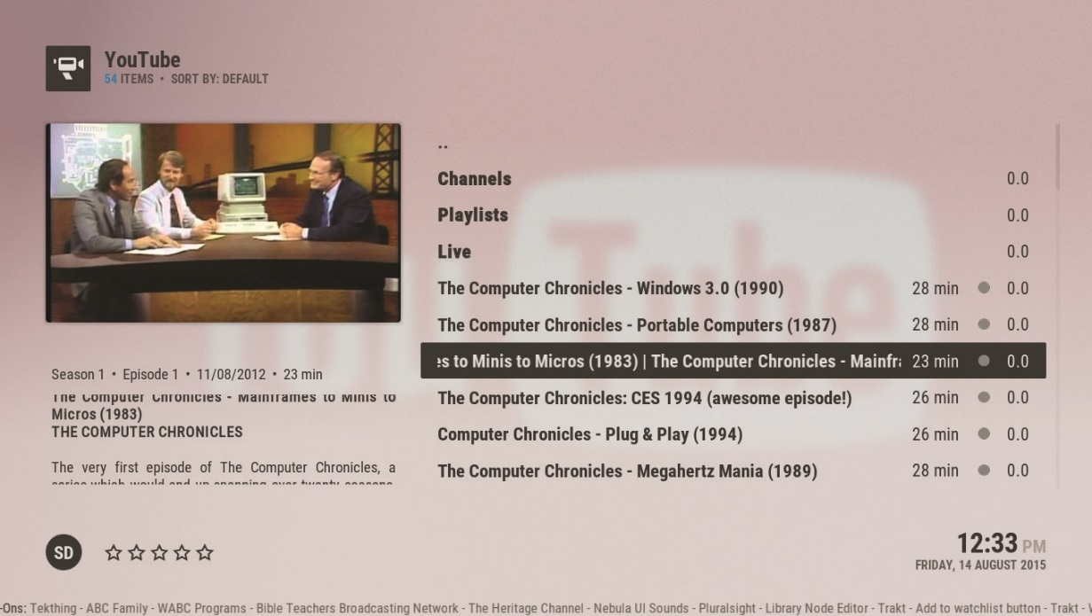
Home Theater PC
Figure 12.16 Kodi sporting the Arctic: Zephyr skin

Slide 36
Gaming PC
Essential features for a gaming PC
Fast, multicore processor
A lot of memory – at least 8 GB, 16 GB for good measure
64 GB if you plan to play five games at once
High-end video card with a specialized graphics processor unit (GPU) for gaming
High-definition sound card to provide optimal positional audio

Slide 37
OS Installing/Upgrading
Media sources
A Windows installation has two steps:
Boot the system from an installation medium.
Answer installation wizard’s initial queries and let it do its thing.
Boot methods
Windows DVD
Removable drive that plugs into USB, FireWire, eSATA, or Thunderbolt ports
Notes:
Exam Tip: The CompTIA A+ 220–902 exam objectives offer “internal hard drive (partition)” as a viable boot method for installing Windows. My best guess is that they mean the hidden recovery partition.

Slide 38
Types of Installation
Clean installation
Installing onto an empty hard drive or completely replacing an existing installation
Upgrade installation
Installing an OS on top of an earlier installed version
Multiboot installation
Installing more than one version of Windows

Slide 39
Clean Installation
Wipes out the old Windows installation
Performed on a new system
No problems from old version carry forward
Must reinstall all applications and reconfigure preferences
Typically performed by setting CMOS to boot from optical drive before the hard drive
Option to partition and format during installation process
Notes:
The CompTIA A+ 902 objectives mention refresh/ restore as an appropriate method of installing Windows, and in some scenarios this is true. Both refresh and restore install some or all of an operating system as an attempt to fix an OS that’s not functioning properly. We’ll cover System Restore in detail in Chapter 15 and tackle Refresh your PC when we hit troubleshooting in Chapter 17.

Slide 40
Upgrade Installation
New OS is installed into the same folders as the old OS.
Data, applications, and personal settings are retained.
Windows Upgrade Advisor is a compatibility tool that checks to see if upgrade is possible.
Called Upgrade Assistant in Windows 8/8.1
Called Windows Upgrade OS Advisor by CompTIA
To begin the Windows upgrade, run the appropriate program from the optical disk.
Notes:
Exam Tip: Microsoft often uses the term in-place upgrade to define an upgrade installation, so you might see it on the CompTIA A+ 902 exam. On the other hand, Microsoft documentation also uses the term for a completely different process, called a repair installation, so read whatever questions you get on the exam carefully for context. For repair installations, see Chapter 17.
Before starting an OS upgrade, make sure you have shut down all other open applications!

Slide 41
Multiboot Installation
Dual-boot or multiboot installation means the system has more than one OS installation.
Choose which OS to use when computer boots.
For a multiboot installation:
Use Disk Management to shrink the volume and create another partition in the newly unallocated space.
Use Boot Camp tool to install Windows on an Apple machine.
Install Linux after Windows, not before.

Slide 42
Other Installation Methods
Install over a network (called a remote network installation)
Can be automated with special scripts to create an unattended installation
Image deployment
An image is a complete copy of a hard drive volume.
Can be stored on optical disks, flash drives, or network servers
Use applications such as Symantec Ghost Solution Suite, Clonezilla, and Acronis’s True Image.

Slide 43
OS Installation and Upgrade
End-user license agreement (EULA)
Enter product key from installation disk’s case.
Upgrade paths
Determine if you can upgrade a client’s computer from X to Y.
The bit size of the currently installed OS must match the bit size of the upgrade OS.

Slide 44
Upgrade Paths
Table 12.3 | Upgrading from Windows 7 to Windows 8
From Windows 7 |  | Upgrade to Windows 8
Starter |  | Windows 8, Windows 8 Pro
Home Basic |  | Windows 8, Windows 8 Pro
Home Premium |  | Windows 8, Windows 8 Pro
Professional |  | Windows 8 Pro, Windows 8 Enterprise
Enterprise |  | Windows 8 Enterprise
Ultimate |  | Windows 8 Pro

Slide 45
Upgrade Paths
Table 12.4 | Upgrading from Windows 7/8/8.1 to Windows 8.1
From Windows 7/8/8.1 |  | Upgrade to Windows 8.1
Windows 7¹ |  | Windows 8.1
Windows 8 |  | Windows 8.1, Windows 8.1 Pro²
Windows 8 Pro |  | Windows 8.1 Pro, Windows 8.1 Enterprise
Windows 8 Pro with Media Center |  | Windows 8.1 Pro, Windows 8.1 Enterprise
Windows 8 Enterprise |  | Windows 8.1 Pro, Windows 8.1 Enterprise
Windows 8.1 |  | Windows 8.1 Pro
Windows 8.1 Pro |  | Windows 8.1 Enterprise
Table 12.4 Upgrading from Windows 7/8/8.1 to Windows 8.1
Notes:
You can upgrade from Windows 7 to Windows 8.1, but you can only keep personal files, not applications.
You can upgrade to Windows 8.1 with one of two methods: through the Windows Store or via upgrade Installing through the Windows Store locks you into the previous edition.

Slide 46
Windows Clean Installation
Windows installer in Vista and later has a full graphical interface.
Installation methods are very similar for Windows Vista/7/8/8.1/10.
Boot from Windows installation media.
Set language, time zone, currency, and keyboard settings.
Install repair tools.
Enter product key.
Vista and Windows 7 had a 30-day grace period.

Slide 47
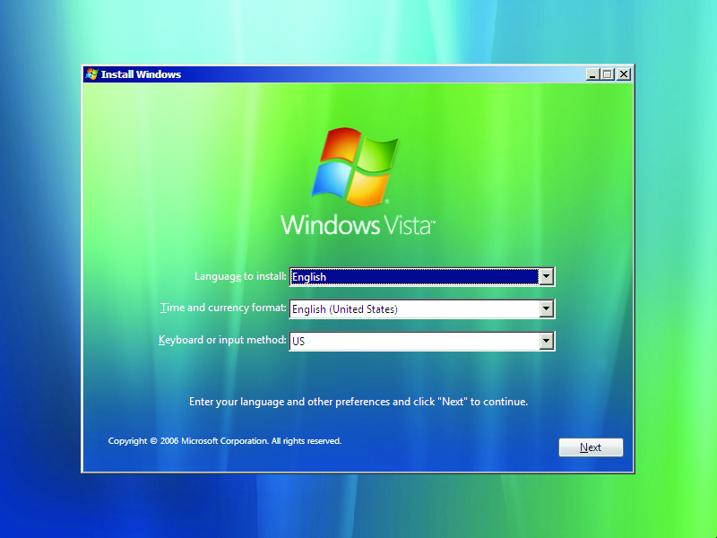
Windows Clean Installation
Figure 12.18 Windows Vista language settings screen

Slide 48
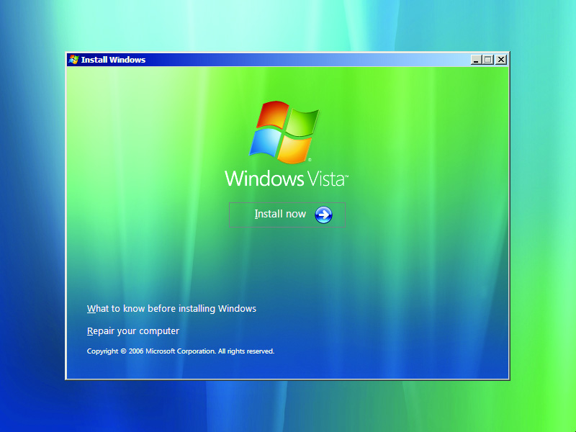
Windows Clean Installation
Figure 12.19 The Windows Vista setup welcome screen

Slide 49
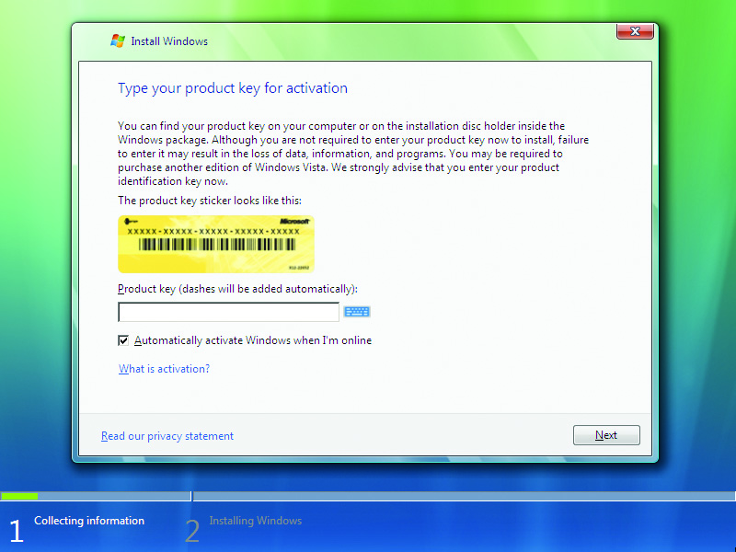
Windows Clean Installation
Figure 12.20 The Windows Vista product key screen

Slide 50
Windows Clean Installation
Accept the end user license agreement.
Decide whether you want to do an upgrade or clean installation.
Choose Custom (advanced) option.
Click the Drive options (advanced) link on the partitioning screen.
Click Load Driver button to load third-party drivers.
Installation process takes over once drives have been partitioned.

Slide 51
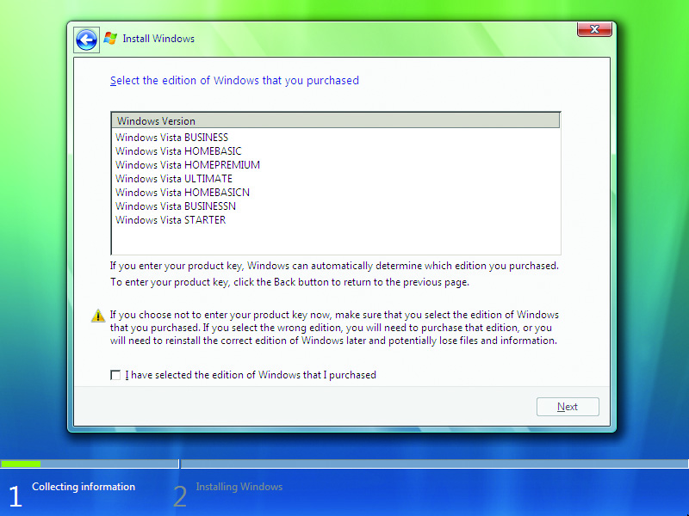
Windows Clean Installation
Figure 12.21 Choose the edition of Vista you want to install.

Slide 52
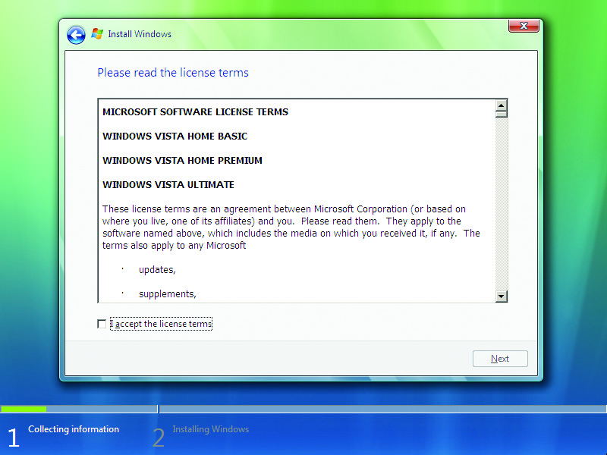
Windows Clean Installation
Figure 12.22 The Vista EULA

Slide 53
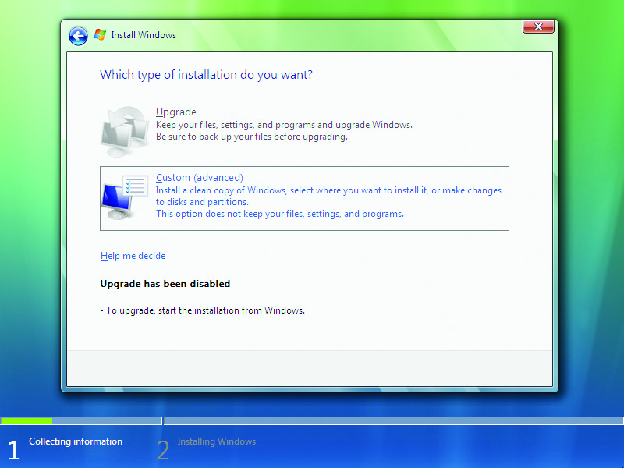
Windows Clean Installation
Figure 12.23 Choose your installation type.

Slide 54
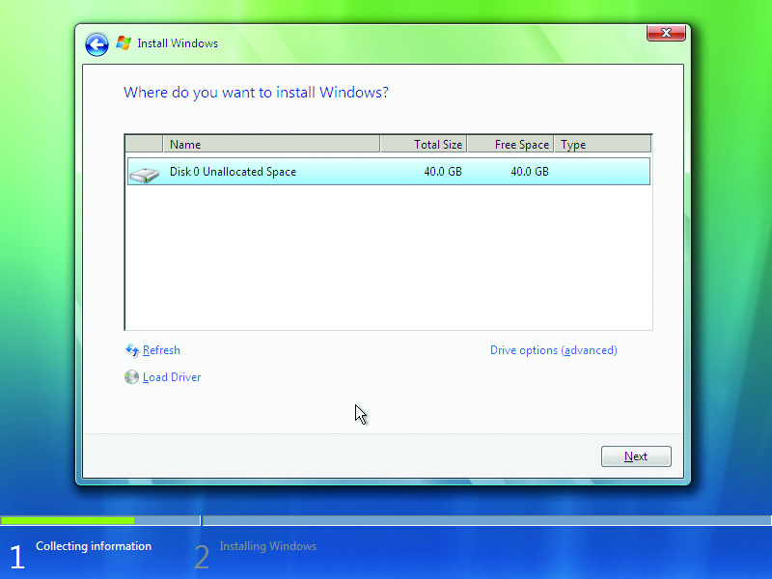
Windows Clean Installation
Figure 12.24 The partitioning screen

Slide 55
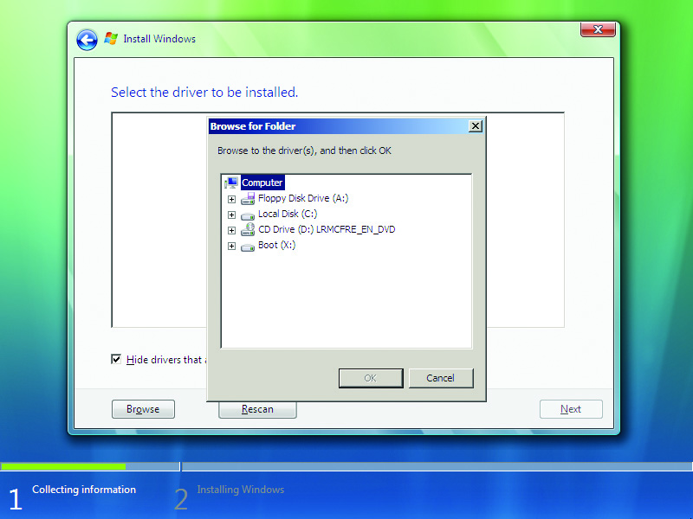
Windows Clean Installation
Figure 12.25 Browse for drivers.

Slide 56
Windows Clean Installation
Choose a user name and picture.
Choose your computer name.
Choose a desktop background.
Enter product activation key.
For Windows 7/8/8.1
Choose how you want to set up Windows Automatic Updates.
Set the correct time zone, date, and time.
Choose current location for network.

Slide 57
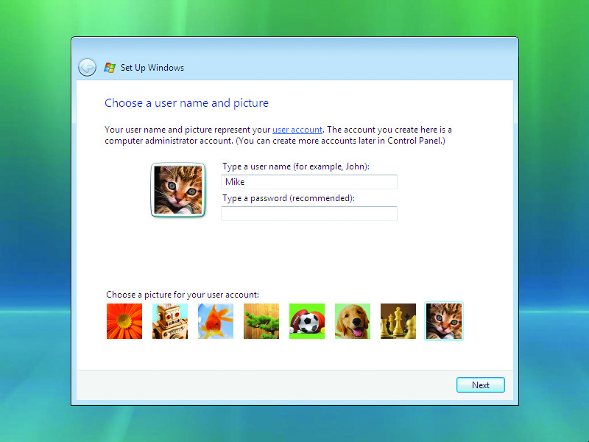
Windows Clean Installation
Figure 12.26 Choose a user picture.

Slide 58
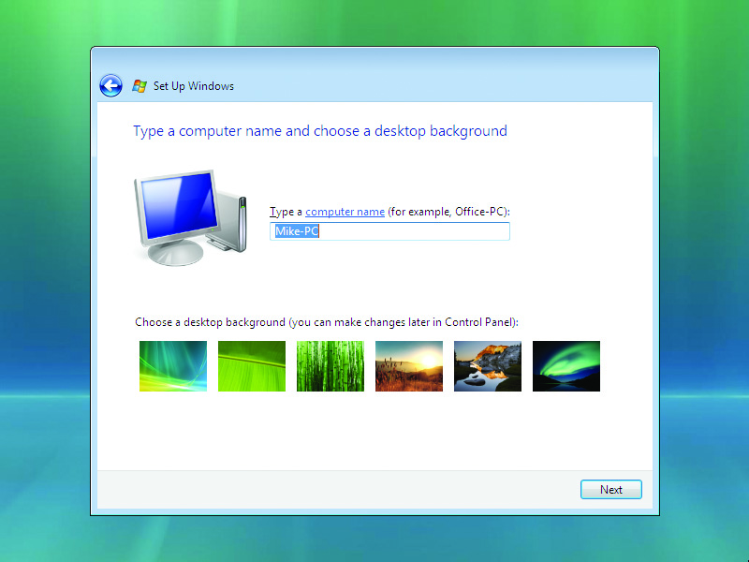
Windows Clean Installation
Figure 12.27 Choose your computer name.

Slide 59
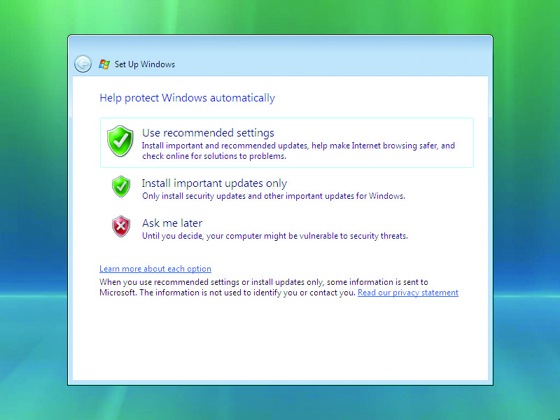
Windows Clean Installation
Figure 12.28 The Automatic Updates screen

Slide 60
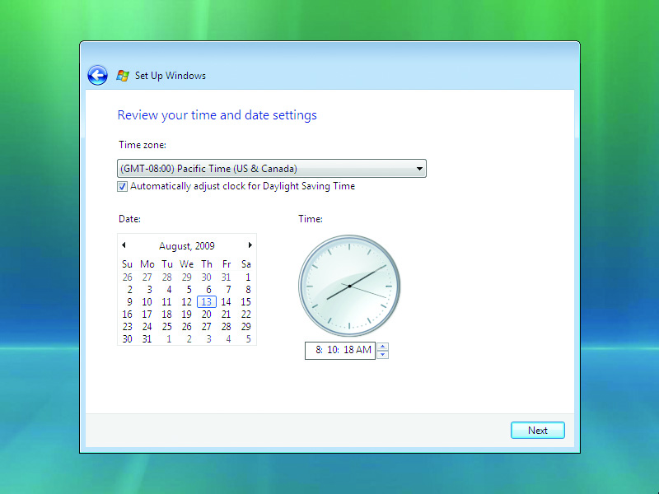
Windows Clean Installation
Figure 12.29 Vista pities the fool who doesn’t know what time it is.

Slide 61
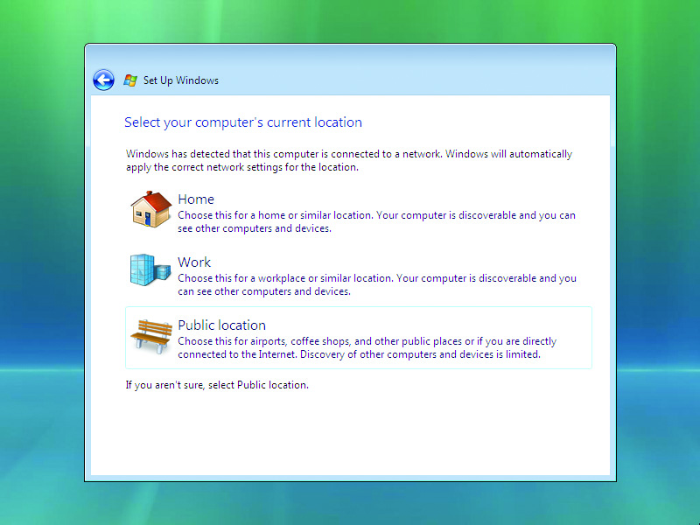
Windows Clean Installation
Figure 12.30 Tell Windows what kind of network you’re on.

Slide 62
Windows Clean Installation
Windows Vista and 7 run tests and assign a performance rating.
Windows boots up.
30 days to activate new operating system if you didn’t already
Without activation within 30 days, goes into a non-genuine mode with reduced functionality

Slide 63
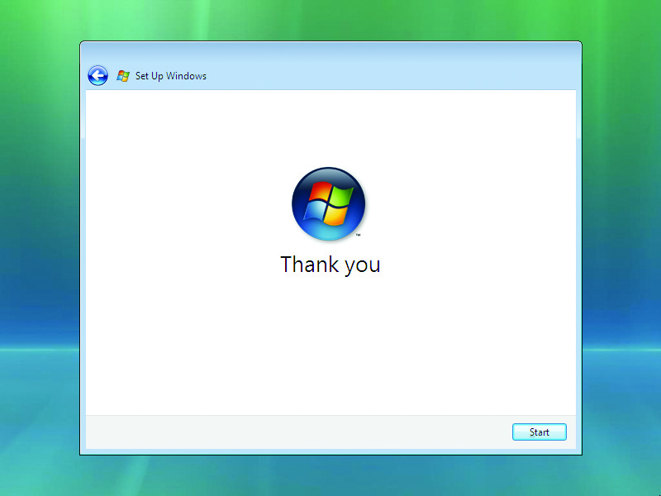
Windows Clean Installation
Figure 12.31 Aw, shucks, Microsoft Windows Vista. Don’t mention it.

Slide 64
Network Installations
Network installation takes automated installation one step further.
Ideal for deploying Windows to multiple workstations across a network without visiting each PC individually
Installation image hosted on a network server that all clients can contact
Clients need to use the Preboot Execution Environment (PXE).

Slide 65
Network Installations
PXE uses multiple protocols such as IP, DHC, and DNS to enable a computer to boot from a network location.
Enable PXE in the BIOS System Setup.
Specify the boot order with network location first.
Multiple installation images may be installed on the server requiring you to choose one from a menu.
If there is only one image, you’ll see the Windows installation screen begin.

Slide 66
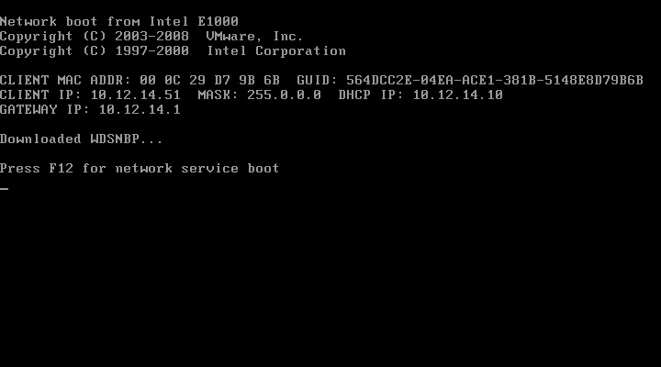
Network Installations
Figure 12.32 Network boot

Slide 67
OS X Network Installation
NetBoot
NetBoot tool allows you to boot many identical Mac machines remotely.
Any user-generated content goes away at reboot.
NetBoot can load identical images on multiple Macs.
This tool can push specific applications to many computers at once.

Slide 68
Troubleshooting Installation
Media errors
RAID Array Not Detected
Get the driver disc from the manufacturer and run setup again.
Press F6 when prompted very early in the Windows installation process.
No boot device present when booting off the startup disk
Replace startup disc or set CMOS to look at optical drive first.
Not ready error on optical drive
Press R for retry a few times.

Slide 69
Troubleshooting Installation
Graphical mode errors
Failure to detect hardware properly can be avoided by researching compatibility beforehand.
Microsoft designed Windows to run on several hardware platforms using the Hardware abstraction layer (HAL).
Lockups during installation
Disk, drive, or image errors may cause lockups.
Try a known good disk.

Slide 70
Troubleshooting Installation
Log files track the progress of certain processes.
Windows creates about 20 log files, organized by installation phase.
Each phase generates a setuperr.log file to track errors.
Log files are stored in the Windows directory.
These files are handy if you call Microsoft or a hardware manufacturer.

Slide 71
Post-Installation Tasks
A patch is a corrective program to fix a problem.
A service pack is a bundle of patches.
Windows 7 was the last version to get one.
Install latest updates immediately after installing Windows.
Turning on Windows Update is the easiest way to accomplish this.

Slide 72
Upgrading Drivers
During installation, you may decide to go with default drivers that come with Windows.
Upgrade to the latest drivers after the fact.
This method gives you a usable driver to go back to if newest one presents a problem.
Notes:
You learned about driver rollback way back in Chapter 7, “Motherboards,” so check your memory now. How do you roll back a driver? When should you roll back a driver?

Slide 73
Restoring User Data Files
After installation, restore backed-up user data.
Method of restore depends on how data was backed up.
Third-party backup program
Backup and Restore Center
Data copied to optical disks, USB, or a network location

Slide 74
Migrating Systems
Migration
Move data and users to a new system.
Safely dispose of the old system.
Microsoft migration tools
User State Migration Tool (USMT)
Runs in Windows Server Active Directory Domain
Windows Easy Transfer
In Windows Vista/7, in System Tools subfolder of Accessories folder in Programs Menu
Search Windows Easy Transfer in Windows 8/8.1
Not available in Windows 10
Notes:
Migrating moves data off drives to new drives, allowing you to recycle the old drive.

Slide 75
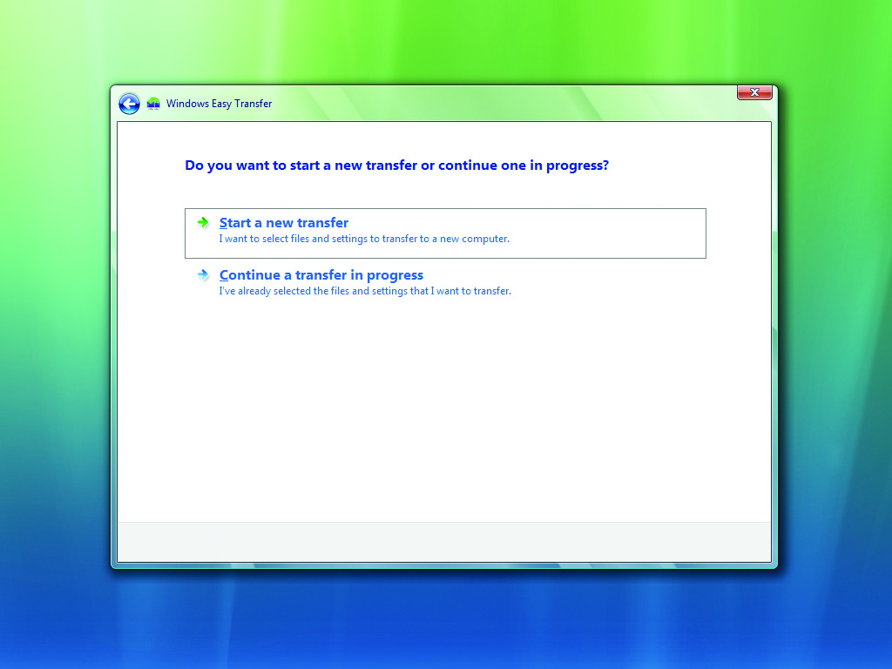
Migrating Systems
Figure 12.33 Start a new transfer or continue one?

Slide 76
Migration Practices
What do you do with the old drive?
Follow these principles:
Migrate in a secure environment.
Remove data remnants from hard drives.
Recycle old equipment; don’t trash it in the trash.
Data destruction is a security measure.
Cleaning a drive is very difficult.
Physically destroy the drive.
Sanitize it with a software utility.

Slide 77
Data Destruction
Sanitizing
The hard drive will still function once data has been destroyed.
Low-level formatting writes zeros to every location on the disk.
Drive wiping utilities erase old, deleted data that hasn’t been overwritten yet.
Piriform’s CCleaner is a data sanitizing utility.

Slide 78
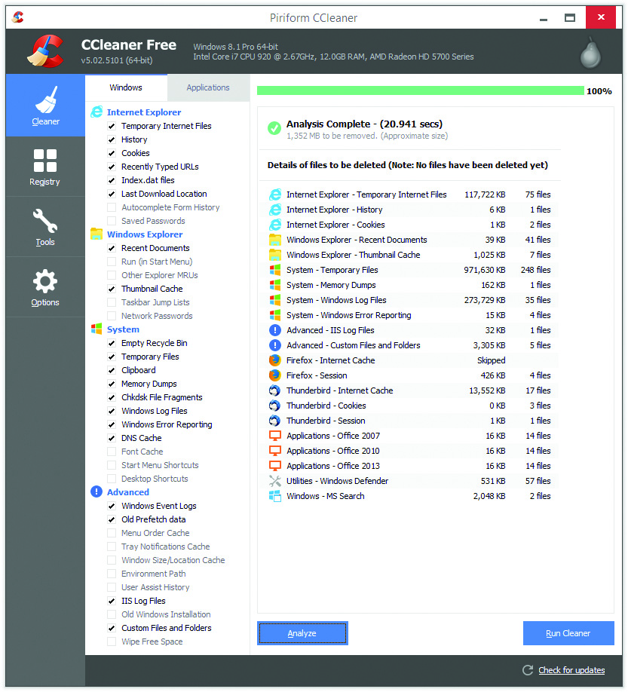
Data Destruction
Figure 12.34 Piriform’s CCleaner showing files to be removed

Slide 79
Recycle
Recycling paper and printer cartridges keeps them out of landfills.
Safely disposing of hazardous materials protects people and the environment.
Thousands of companies specialize in computer recycling.
Local municipal waste authority offers drop-off options.
Donate to an organization that refurbishes and uses older PCs in schools, etc.

Slide 80
No Installation is Perfect
Be prepared to reinstall applications or deal with new functions that were absent in the previous OS.
If you have an OEM computer, it likely includes a special recovery partition on the hard drive.
Recovery disk or recovery flash drive
To restore factory settings

Slide 81
Installing Windows 10
Upgrade from Windows 7/8/8.1 is free if upgraded before July 29, 2016.
Logging in with a Microsoft account (Hotmail or Outlook) enables Windows to access much personal information.
Consider using an old-style local user account.
Use Privacy utility in the Settings app to opt out of what Windows does with some of your information.
Notes:
Microsoft produces many editions of Windows 10 to accommodate the diversity of uses and devices. Editions include Home, Mobile, Pro, Enterprise, Education, and more.

Slide 82
Questions?

Slide 83
Summary
Research and spec out specialized PCs
Install and upgrade Windows
Describe Windows post-installation best practices

Slide 84


